Slide 1
Solving Problems and Overcoming Obstacles in GAAP LDTI Webcast
Moderator/Presenter: Scott D. Houghton, FSA, MAAA
Presenters: Bill Cember, FSA, MAAA
Katherine M Papillon-Rodrigue ASA,CERA
January 20, 2021

Slide 2
SOA Antitrust Compliance Guidelines
Active participation in the Society of Actuaries is an important aspect of membership. While the positive contributions of professional societies and associations are well-recognized and encouraged, association activities are vulnerable to close antitrust scrutiny. By their very nature, associations bring together industry competitors and other market participants.
The United States antitrust laws aim to protect consumers by preserving the free economy and prohibiting anti-competitive business practices; they promote competition. There are both state and federal antitrust laws, although state antitrust laws closely follow federal law. The Sherman Act, is the primary U.S. antitrust law pertaining to association activities. The Sherman Act prohibits every contract, combination or conspiracy that places an unreasonable restraint on trade. There are, however, some activities that are illegal under all circumstances, such as price fixing, market allocation and collusive bidding.
There is no safe harbor under the antitrust law for professional association activities. Therefore, association meeting participants should refrain from discussing any activity that could potentially be construed as having an anti-competitive effect. Discussions relating to product or service pricing, market allocations, membership restrictions, product standardization or other conditions on trade could arguably be perceived as a restraint on trade and may expose the SOA and its members to antitrust enforcement procedures.
While participating in all SOA in person meetings, webinars, teleconferences or side discussions, you should avoid discussing competitively sensitive information with competitors and follow these guidelines:
-Do not discuss prices for services or products or anything else that might affect prices
-Do not discuss what you or other entities plan to do in a particular geographic or product markets or with particular customers.
-Do not speak on behalf of the SOA or any of its committees unless specifically authorized to do so.
-Do leave a meeting where any anticompetitive pricing or market allocation discussion occurs.
-Do alert SOA staff and/or legal counsel to any concerning discussions
-Do consult with legal counsel before raising any matter or making a statement that may involve competitively sensitive information.
Adherence to these guidelines involves not only avoidance of antitrust violations, but avoidance of behavior which might be so construed. These guidelines only provide an overview of prohibited activities. SOA legal counsel reviews meeting agenda and materials as deemed appropriate and any discussion that departs from the formal agenda should be scrutinized carefully. Antitrust compliance is everyone’s responsibility; however, please seek legal counsel if you have any questions or concerns.

Slide 3
Presentation Disclaimer
Presentations are intended for educational purposes only and do not replace independent professional judgment. Statements of fact and opinions expressed are those of the participants individually and, unless expressly stated to the contrary, are not the opinion or position of the Society of Actuaries, its cosponsors or its committees. The Society of Actuaries does not endorse or approve, and assumes no responsibility for, the content, accuracy or completeness of the information presented. Attendees should note that the sessions are audio-recorded and may be published in various media, including print, audio and video formats without further notice.

Slide 4
TI – VA Business Context
Bill Cember, FSA, MAAA

Slide 5
Business Context
Where are We?
2013
The FASB issued an exposure draft with proposed changes to insurance contract accounting
Things are too complicated!
2018
Specific guidance issued in ASU-2018
2020
Implementation well underway for 1/1/2023 adoption (or 1/1/2022 if early adopting)

Slide 6
Business Context
Quality of Earnings - Definition
Comparability
Allow the performance of a company to be assessed and evaluated against comparable companies
Sustainability
Change period-over period should be from operating performance and market changes, not accounting mismatches
Economic
Value of assets/liabilities should reflect their intrinsic value

Slide 7
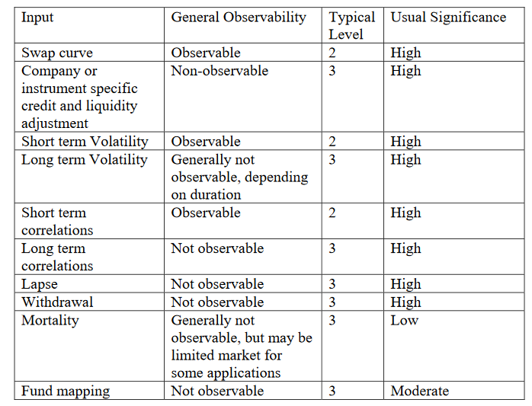
Business Context
Fair Value
Level 1
Value reported is based on an unadjusted quote price from active markets
Level 2
Value reported includes items other than quoted prices that are observable to market participants
Level 3
Value reported includes at least one non-observable input
E.g. value of public equity a company holds
E.g. value of a non life contingent payout annuity
E.g. value of a life contingent payout annuity

Slide 8
Business Context
Quality of Earnings – Valuation of Companies’ Annuity Living Benefit Riders
Characteristic | Pre-TI | Post-TI
Comparability | Some companies value liabilities under a fair value framework (FAS 157) while others value under insurance accrual (SOP 03-1) or some combination thereof | Much more comparability—all companies required to value under fair value.
Sustainability | If liabilities valued under an insurance accrual model while hedge assets valued at fair value, then resulting changes period-of-period from accounting differences. | Common framework for valuing hedge assets and liabilities
Economic | Only one intrinsic value, not two | Fair value more economic than insurance accrual, although can be argued certain aspects (e.g. NPR spread) non-economic

Slide 9
Business Context
Recent VA M&A
2017 – Metlife spins-off of Brighthouse
2018 – AXA spins-off Equitable
2018 – Talcott Resolution becomes an independent entity from The Hartford
2018 – Venerable formed as an acquisition of Voya’s VA closed block.
2020 – Venerable reinsures a significant portion of Equitable’s VA block

Slide 10
Business Context
GAAP & Non-GAAP Financial Measures
Company | GAAP GMWB Treatment | Uses Additional Non-GAAP Financial Measure?
Prudential | Fair Value | Yes
Equitable | Fair Value | Yes
Lincoln Financial | Combination | Yes
AIG | Fair Value | Yes
Brighthouse | Combination | Yes
Top VA writers subject to GAAP are all using non-GAAP financial measures in addition to GAAP
Different treatment of living benefit riders by company
How the heck are ordinary investors supposed to understand this?

Slide 11
Business Context
Non-GAAP Financial Measures
Goals
Remove mismatches between assets and liabilities
Remove items not expected to re-occur in the future
Address non-economic nature of certain GAAP items
Issues
Different measures for every company
Less transparency than GAAP measure around methodology
Ability for management to change methodology period-over-period
Example adjustments in non-GAAP financial measures
Realized gains/losses associated with fair value changes on riders and hedge assets
Change in reserves from benefit ratio unlocking
GMIB fees & costs
Covid-19 Impacts

Slide 12
Liability Changes
DAC
What
DAC amortized over expected life of the contact rather than expected gross profits
Now What?
More easily predictable expense pattern for investors
Other changes such as shadow DAC no longer applying, removal of need for impairment testing
Why
Simplified amortization and increased understandability for investors
DAC amortization no longer dependent on investment of underwriting results

Slide 13
Liability Changes
Market Risk Benefits
What
Reserves for annuity riders must now be measured at fair value rather than as an insurance accrual (i.e. FAS 157 rather than SOP 03-1)
Now What?
Greater consistency in measurement of liabilities and hedge assets
Why
One measurement model for all companies; improved comparability for investors
Given changes in GAAP, how will companies change their non-GAAP financial measures? Are they even needed?
Given changes in liability measurement, how/if will companies change how they hedge?

Slide 14
Liability Changes
Enhanced Disclosures
What
Enhanced disclosure requirements such as quarterly liability rollforwards, actual to expected experience, and information around inputs, assumptions and methods used in valuing MRB’s
Now What?
To what extent will disclosures be useful to investors?
Why
Increased transparency into liability changes and resulting comparability across companies
Will enhanced disclosures and simplifications in liability measurement remove the complexity stigma around variable annuities?
Will PE ratios improve?

Slide 15
Reinsurance
Katherine Papillon-Rodrigue, ASA, CERA

Slide 16
Reinsurance
What is changing?
No specific changes to the reinsurance guidance
Ongoing discussion in AICPA industry group
Assumed Reinsurance Items
item | Description
12A | Under LDTI, what date the reinsurance contract enter date be used?
12B | Unit of Account to use in NRP calculation for reinsurance contracts with fixed non-cancellable terms
12C | Unit of account for assuming reinsurance that contain multiple products
Notes:
https://www.aicpa.org/interestareas/frc/industryinsights/long-duration-insurance-accounting-issues.html

Slide 17
Reinsurance
What is changing?
AICPA - Ceded Reinsurance Items
https://www.aicpa.org/interestareas/frc/industryinsights/long-duration-insurance-accounting-issues.html
item | Description
11AC | Trad and Limited Pay LD – Reinsurance recoverable and cost of reinsurance; application of net premium cap and floor
11B | For inforce transaction, what direct liabilities to be used?
11D | Accounting policy change allowed to include COR in Loss Recognition testing?
11EF | MRB Fee
Notes:
https://www.aicpa.org/interestareas/frc/industryinsights/long-duration-insurance-accounting-issues.html

Slide 18
Reinsurance
What can be done now?
Review current reinsurance approximations base of direct side changes
Look for guidance on similar principled regulation
  Canadian GAAP
  IFRS 17
Required disclosure vs information desired by management

Slide 19
Reinsurance
Process Flow
Evaluate current Infrastructure
  Data available and flow of it
  Modeling platform
  Ledger
Initial implementation vs long term strategy

Slide 20
Assumption Setting under LDTI for Traditional and Limited Pay Contracts
Scott D. Houghton, FSA, MAAA

Slide 21
Discount Rate Under ASU 2018-12
ASU 2018-12 Text
“The liability for future policy benefits shall be discounted using an upper-medium grade (low credit-risk) fixed-income instrument yield.
“An insurance entity shall consider reliable information in estimating the…yield that reflects the duration characteristics of the liability for future policy benefits”
“An insurance entity shall maximize the use of relevant observable inputs and minimize the use of unobservable inputs in determining the discount rate assumption.”

Slide 22
Discount Rate Under LDTI
Credit risk level and duration prescribed
Consensus to use “A” rated bond yield
Observable and non-observable inputs
Bond maturities limited and can be shorter than insurance liability durations
Other investment risks not prescribed
Some interpretation needed for liquidity risk, prepayment risk, convexity risk
Use of liability duration removes differences in duration risk in company investment policies
Observed rates can vary based on risks

Slide 23
Discount Rate Under LDTI

Slide 24
Setting the Discount Rate
Sample Illustrative Process
Data
Collect and analyze observable input
Fitting
Fit, smooth and develop observed yield curve or rate
Review and Recommend
Implement process for review and recommend assumption
Finalize
Updated each reporting period
Two projection runs needed

Slide 25
Cash Flow Projection Assumptions
Based on estimates of future experience without margins
Mortality
Mortality improvement included to extent it is part of company view for estimate of future experience
Morbidity
Based on expected incidence of disability and claim cost
Termination
Amounts can vary based on plan, issue year, premium mode, and other factors
Expense
Separation of expense amounts needed to administer benefits
Include lapses on products without cash surrender value
Vary by contract type, class, gender, age, and benefit period

Slide 26
Cash Flow Projections Assumptions
Assumption updates and breakdowns
Updates
ASU 2018-12 Summary: “review and, if there is a change, update the assumptions used to measure cash flows at least annually”
Breakdowns
Disclosures required that illustrate actual and expected (based on assumptions) at different levels of grouping

Slide 27
Reporting Assumptions
Assumptions more granular due to required disclosures under LDTI
ASU 2018-12 “The balance of capitalized acquisition costs shall be reduced for actual experience in excess of expected experience (that is, as a result of unexpected contract terminations).”
Required disclosures and rollforwards of actual and expected experience

Slide 28
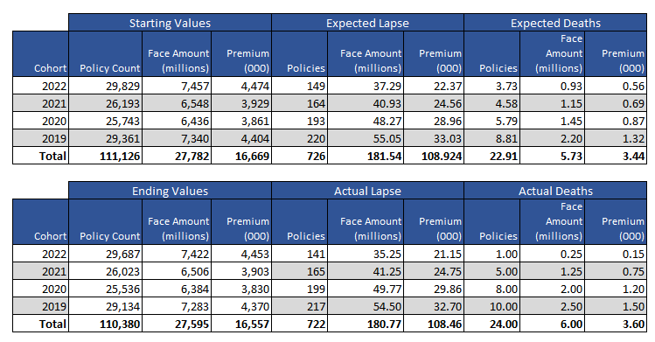
Information Needed
Sample data for reporting Period Q1 2023

Slide 29
Math in LDTI Assumption Setting Process
Credibility Theory
Appropriate weighting of company experience
Statistical Testing
Rejection tests
Formula Fitting
Non-linear regression

Slide 30
Sources of Information
Augmenting Company Experience for Setting Assumptions under LDTI
Company
Company experience
Reinsurers
Reinsurers have access to larger pools of information
Industry
Industry data for comparable products

Slide 31
Comparison of Assumptions
Assumption Setting Under Different Standards
Standard | Assumptions | Assumption Updates
(ASC) 944-60-25-9,(FAS60) GAAP Pre-LDTI | Best estimate plus provision for risk of adverse deviation | Locked in*
Life Products under VM-20 | Prudent estimate = Anticipated experience plus margin for adverse deviation | Mortality at least triennially**
LDTI | Best estimate of future experience | Review annually and update if there is a difference

Slide 32
Changes to Assumption Setting Process
Changes under LDTI to make process formal and consistent
Experience Studies
Need granular groupings of data to determine actuals
Assumption Review and Recommendation Process
Processes need consistency from period to period
Assumption Approval Process
Formal approval and sign off
Finalize
Need to state criteria for approval
Need to know actual and expected

Slide 33




Controls on Assumption Setting under LDTI
Data
Controls and checks required on the data process, including files, collection, validation
Assumption Review and Recommendation
Process needs to be documented
Approval
Process needs documentation and controls applied
Experience Studies
Studies written and follow actuarial standards
Controls applied to process
Controls applied to process

Slide 34
Long Duration Insurance Products
Impact of LDTI based assumptions for LTDI, LTCI, and life products
Life
Book value accounting goes into retirement
Disability Income
ALR similar to life products
Long Term Care
Unlocking of interest and morbidity
DLR similar to current treatment

Slide 35
Questions?

Slide 36
Please remember to complete the webcast evaluation:
http://soa.qualtrics.com/jfe/form/SV_2bJ5s2qXY8PoWpf

